Slide 1
XDIS The Big Picture
Pascal Christian

Slide 2
Acronym “XDIS”
?
?
?
?
?
?
X D I S
?
Cross-platform
Data
Information
System
„XDIS“ is not a very meaningful name… it is the successor of „CAN-DIS“, a tool which handled the CAN bus only.

Slide 3
Agenda
Where are we?
What are our challenges?
How is XDIS used?

Slide 4

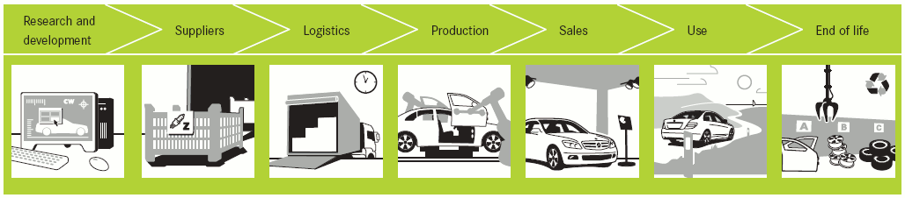
Where are we located in the Daimler world?
Daimler is a very large company!
> 300.000 employees
hundred of systems
huge processes all around the lifecycle of a vehicle
It is important to know where XDIS is „located“ in the Daimler world

Slide 5
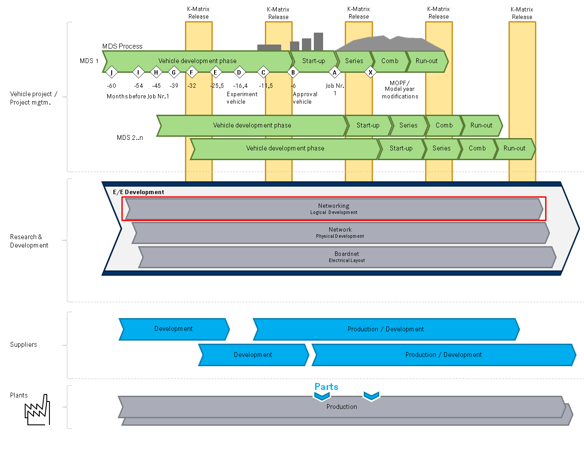





Slide 6
Agenda
Where are we?
What are our challenges?
How is XDIS used?

Slide 7
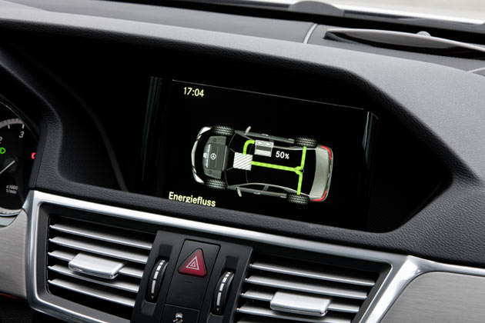
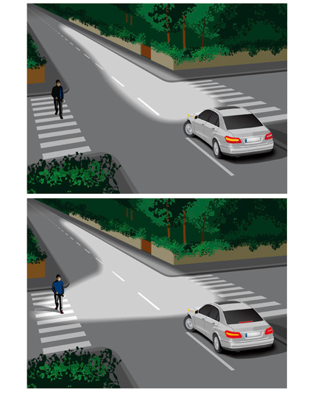
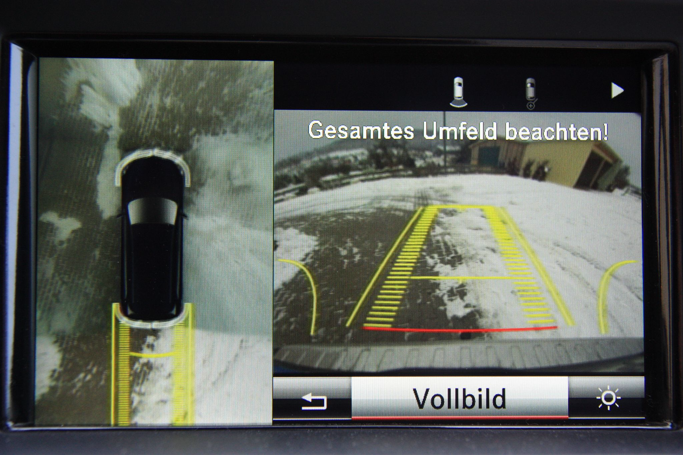
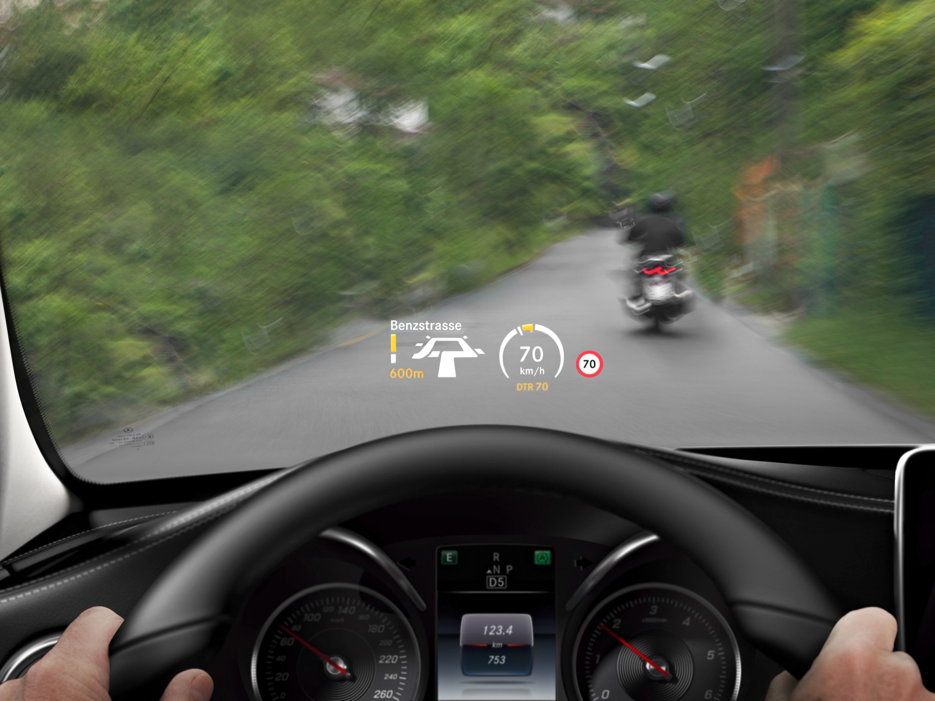
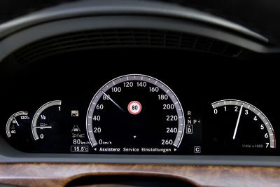
Which challenges does Daimler has to face when it comes to E/E?
In a modern vehicle, there are a lot of assistance and comfort systems
Energy Flow Display
360° camera with targeting lines
Head Up Display (HUD)
Intelligent Light
Speed sign recognition

Slide 8

Which challenges does Daimler has to face when it comes to E/E?
In a modern vehicle, there are a lot of assistance and comfort systems
Energy Flow Display
360° camera with targeting lines
Head Up Display (HUD)
Intelligent Light
Speed sign recognition
Magic Body Control

Slide 9
Which challenges does Daimler has to face when it comes to E/E?
In a modern vehicle, there are a lot of assistance and comfort systems
Energy Flow Display
360° camera with targeting lines
Head Up Display (HUD)
Intelligent Light
Speed sign recognition
Magic Body Control Advertisment

Slide 10
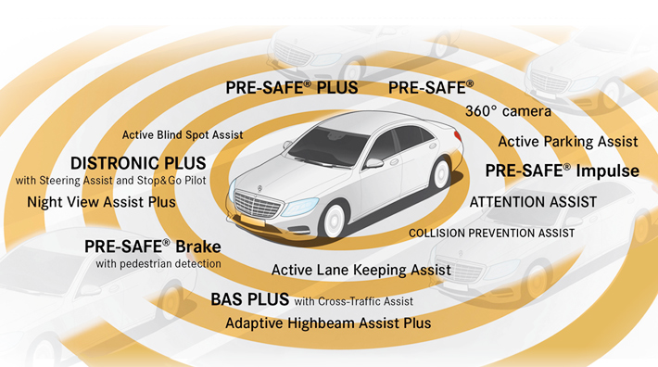
Which challenges does Daimler has to face when it comes to E/E?
All these features must be fully integrated and connected in the vehicle
Information has to be transferred through the whole vehicle

Slide 11
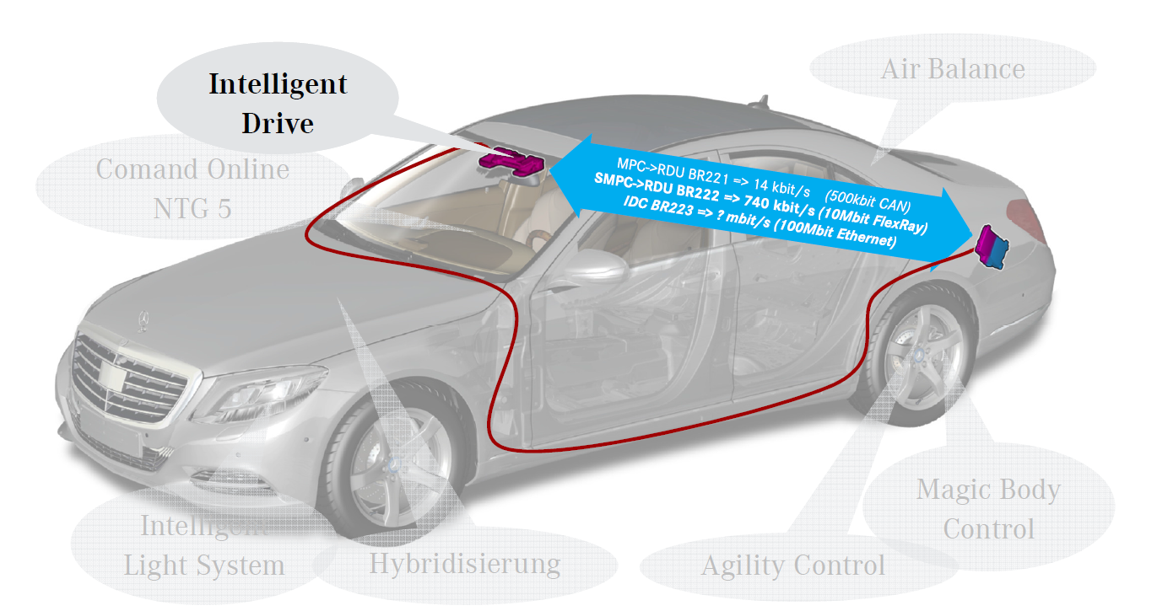
Which challenges does Daimler has to face when it comes to E/E?
(S)MPC = (Stereo/3D) Multi Purpose Camera
RDU = Radar Decision Unit

Slide 12
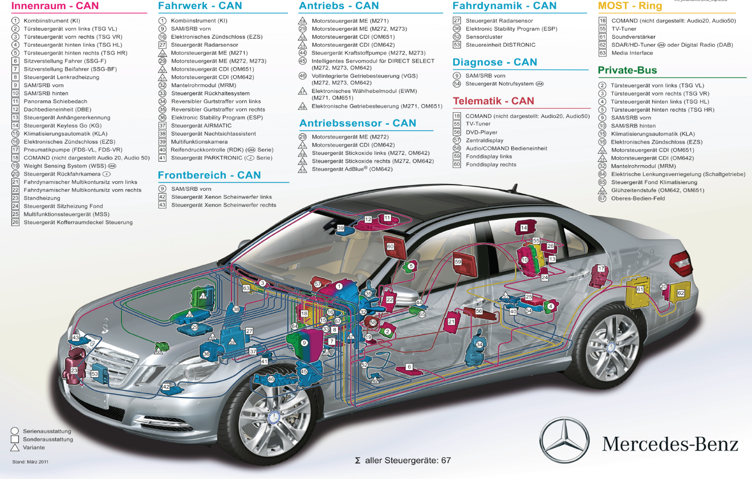
Which challenges does Daimler has to face when it comes to E/E?
Current S-Class (W222): 150 ECUs with LIN, CAN and FlexRay
W140 (1991): 5 ECUs

Slide 13
Which challenges does Daimler has to face when it comes to E/E?
Idea of Platforms:
Platform: STAR 3
ECU Parktronic
ECU Door
ECU HeadUnit
ECU Tire Pressure
ECU Roof
W222 (S-Class)
W212 (E-Class)
R172 (SLK)
ECU RoadHole Recognition

Slide 14
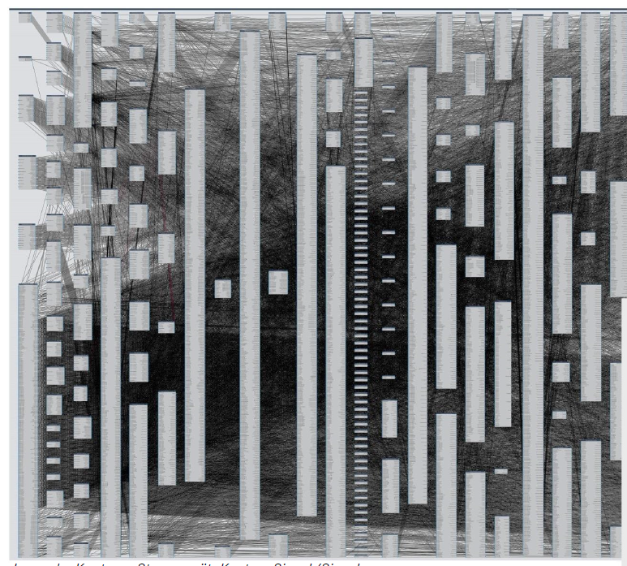
Which challenges does Daimler has to face when it comes to E/E?
What else?
Lots of communication: more than 13.000 signals
Modifications affect many other ECUs
Development of ECUs is done with several different suppliers
Box: ECU, Line: Signal/Signal Group

Slide 15
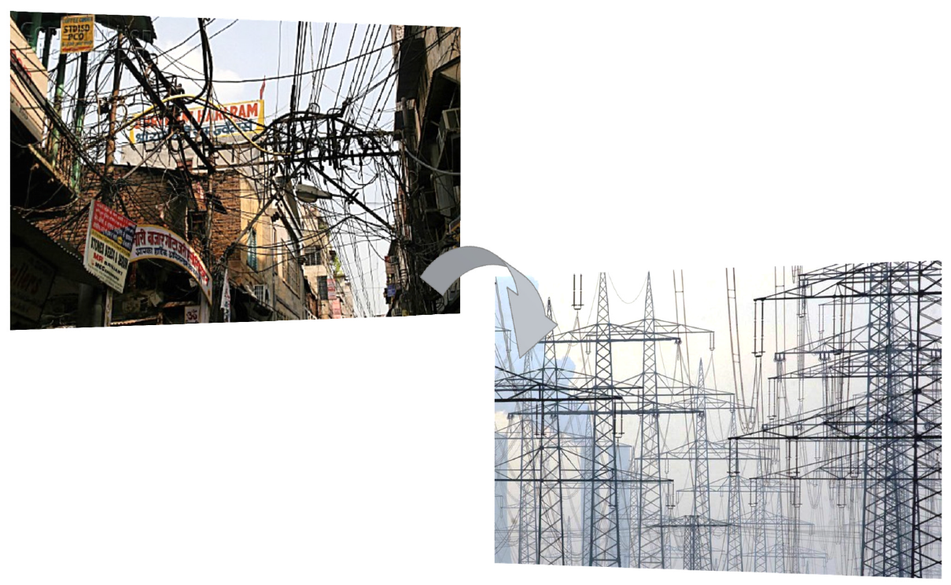

How does Daimler try to master these challenges?
Standardization
AUTOSAR Standard
Bus systems
Development of bus systems / networks
Networking
System based communication design
Providing VMM matrices (K-Matrix) for all model ranges
This is where XDIS comes in!

Slide 16
Agenda
Where are we?
What are our challenges?
How is XDIS used?

Slide 17
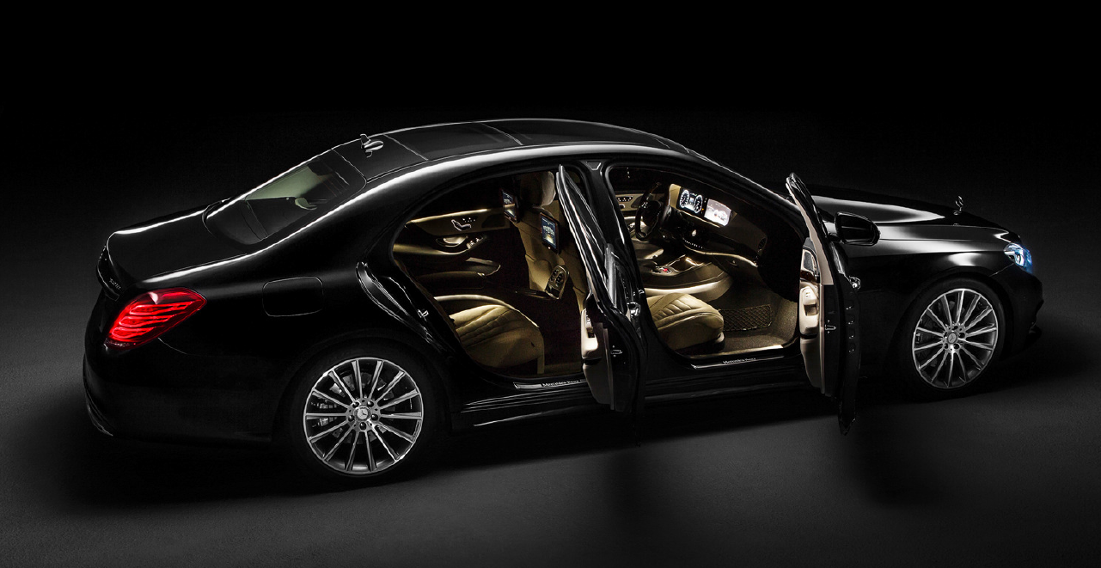
Example Indoor Light
Daimler confidential

Slide 18
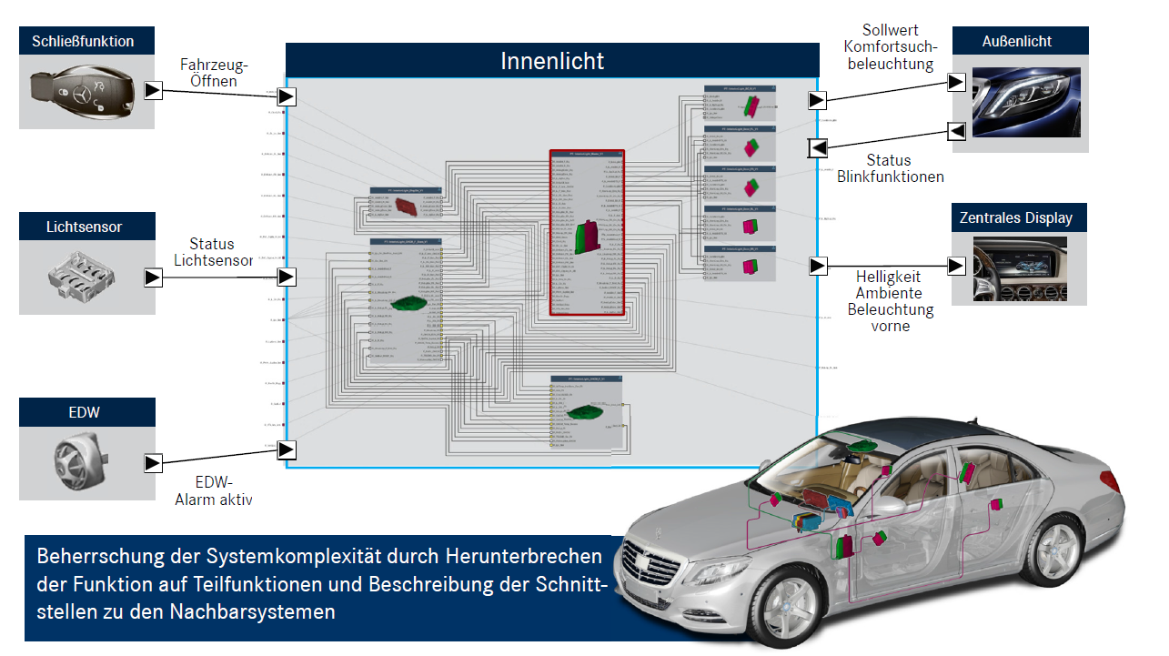
Example Indoor Light
Daimler confidential
First step
Split functions and model interfaces to other systems
Closing function
Indoor light
Light sensor
Central display
Break down the complexity of the complete system by splitting functions and by describing the interfaces to the neighbour systems

Slide 19
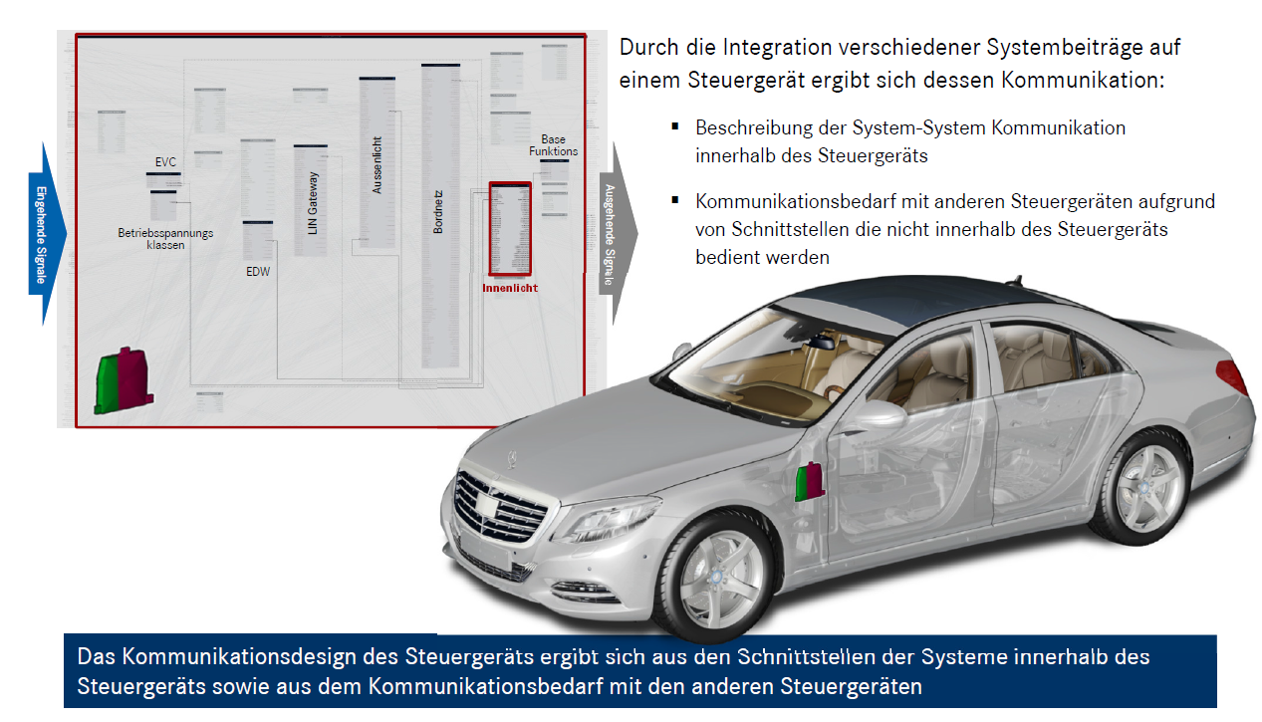
Example Indoor Light
Daimler confidential
Second step
Integrate single component contributions on ECU BC-F (Body Controller Front)
With the integration of different component contributions in one control unit the communication gets clear:
Description of System-System communication within the ECU
Communication with other ECUs because of interfaces which are not offered within the ECU
The design of the communication of the control unit result from the interfaces of the systems within the control unit and of the communication with other control units

Slide 20
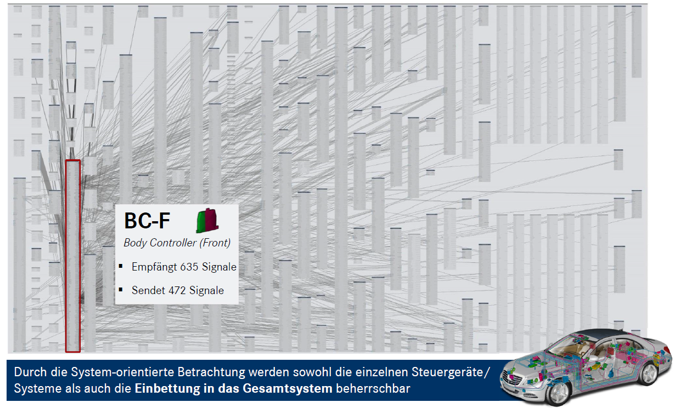
Example Indoor Light
Daimler confidential
Result: Networking of complete system (BC-F)
Receives 635 signals
Sends 472 signals
With help of the system oriented approach as well the single ECUs / systems and the embedment into the complete system keeps controllable

Slide 21
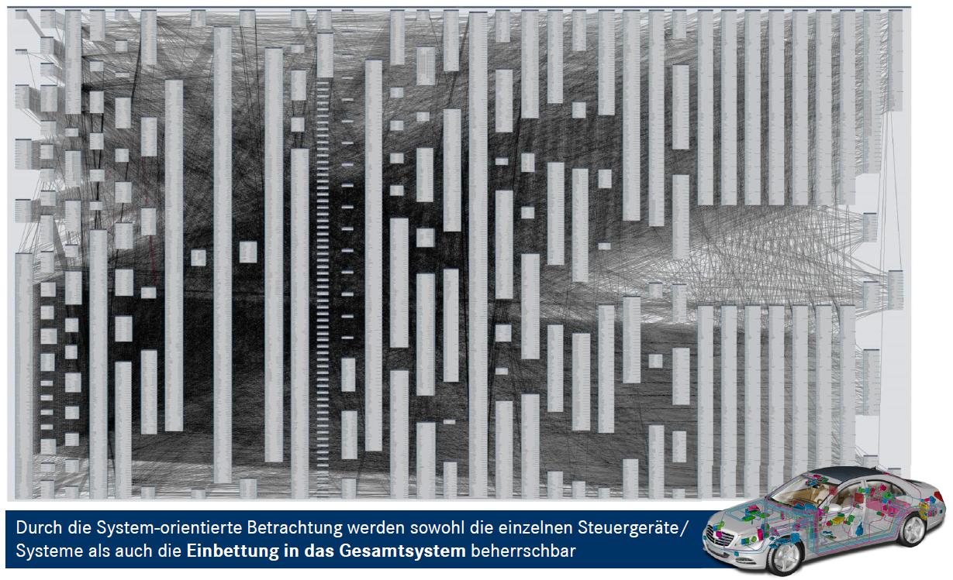
Example Indoor Light
Daimler confidential
Result: Networking of complete vehicle
With help of the system oriented approach as well the single ECUs / systems and the embedment into the complete system keeps controllable

Slide 22
